Slide 1
DOM Access Methods
Mr Mack 2022

Slide 2
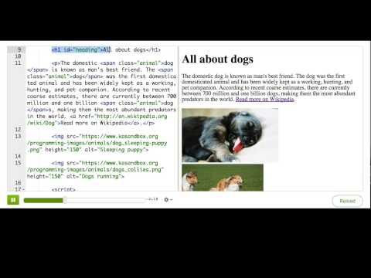
Finding elements by ID

Slide 3

Practice: ID changer
This webpage has an h1 with a placeholder name in it. In this challenge, you'll use JavaScript to replace that with your own name.
For this first step, declare a variable and store the element inside it. You can find the element by passing the ID of the h1 as a string to the document.getElementById() function.
Store the heading in a variable

Slide 4
Practice: ID changer
Now that you have the element stored in a variable, use the innerHTML property to change it to your own name (or username!).
Tip: Make sure you spell your variable name correctly when you reference it the second time.
Change it to your name

Slide 5
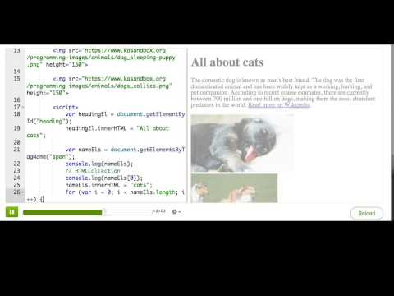
Finding multiple DOM elements by tag or class name

Slide 6
Practice: Custom name tags
This webpage uses divs to create name tags for a few famous computer scientists. In this challenge, you'll use JavaScript to change the text of all the h1s in the name tags. In this first step, use document.getElementsByTagName to find all the headings, and store them in a variable.
Store the headings in variables

Slide 7

Practice: Custom name tags
Now that you've stored the headings in variables, use a for loop to iterate over them and change the text to something else, like 'Hello, world' or 'Allo'.
Change the headings

Slide 8
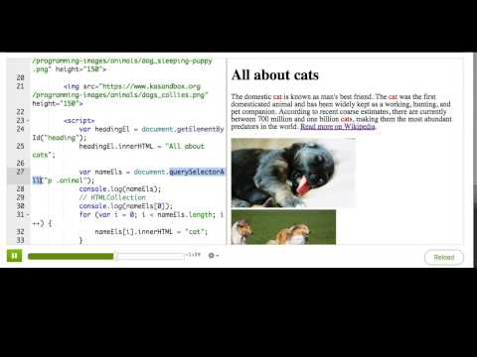
Finding elements by CSS selector

Slide 9
Practice: Query modernizer
This webpage displays a selection of Isaac Newton's Queries, a book from the 1700s. Back then, Newton used the word 'doth' instead of 'does', because that's how English was spoken. In this challenge, you'll change all instances of 'doth' to 'does'. Each of them is surrounded by a <span> with a class of 'doth'. For the first step, use document.querySelectorAll to find only the 'doth's that are inside the list, and store them in a variable.
Select the elements

Slide 10
Practice: Query modernizer
Now that you've stored the elements in variables, use a for loop to iterate over them and change the text of each element to 'does'.
Change 'doth' to 'does'

Slide 11
Practice: Query modernizer
Read through the text, did all of the words get replaced like you expected?
Bonus: Once you complete this challenge, you can spin it off and see if you can replace the words while retaining their capitalization ('doth' to 'does', 'Doth' to 'Does').
Did it work?

Slide 12
Summary: DOM access methods

Slide 13
What methods can we use?
We showed how you can use the following methods to find an element or elements in your webpage:
document.getElementById(id)
document.getElementsByClassName(className)
document.getElementsByTagName(tagName)
document.querySelector(cssSelector)
document.querySelectorAll(cssSelector)

Slide 14
What do they return?
There are two methods that return a single Element object, getElementById and querySelector:
var salsMotto = document.getElementById("salsMotto");
salsMotto.innerHTML = "Math is cool";

Slide 15
What do they return?
The methods getElementsByClassName and getElementsByTagName return an HTMLCollection object that acts like an array. That collection is "live", which means the collection is updated if additional elements with tag name or class name are added to the document.
var teamMembers = document.getElementsByClassName("team-member");
for (var i = 0; i < teamMembers.length; i++) {
console.log(teamMembers[i].innerHTML);
}

Slide 16
What do they return?
The method querySelectorAll() returns a NodeList, which also acts like an array. That list is "static", which means that the list won't update even if new matching elements are added to the page. Most likely, you won't run into the difference between the two return data types when you're using these methods, but it's good to keep in mind.
var teamMembers = document.querySelectorAll(".team-member");
for (var i = 0; i < teamMembers.length; i++) {
console.log(teamMembers[i].innerHTML);
}

Slide 17
Accessing with sub-queries
Once you've found an element, you can do subqueries on it using the methods we've just shown. For example:
// find the element with that ID
var salsMotto = document.getElementById("salsMotto");
// find the spans inside that element:
var mottoWords = salsMotto.getElementsByTagName("span");
// log out how many there are
console.log(mottoWords.length);

Slide 18
Traversing the DOM
Another way to access elements is to "traverse" the DOM tree. Each element has properties that point to elements related to it:
firstElementChild
lastElementChild
nextElementChild/nextElementSibling
previousElementChild/previousElementSibling
childNodes
childElementCount
For example:
var salsMotto = document.getElementById("salsMotto");
for (var i = 0; i < salsMotto.childNodes.length; i++) {
console.log(salsMotto.childNodes[i]);
}
Notes:
These properties are not available on Text nodes, only on Element nodes. To make sure you can traverse an element, you can check its nodeType/nodeValue properties. You likely will not need or want to use DOM traversal, but it is another option available to you.

